Slide 1
JavaScript Fundamentals
By Rasmus Vestergaard Hansen

Slide 2
Agenda
Part 1: Introduction
Language Overview
Language Features
Language Quirks
Part 2: Excercises

Slide 3
Language Overview
”JavaScript is classified as a prototype-based scripting language with dynamic typing and first-class functions. This mix of features makes it a multi-paradigm language, supporting object-oriented,^{[6]} imperative, and functional^{[1][7]} programming styles.” [Wikipedia]

Slide 4
Language Features
Types
Imperative and Structured
Dynamic
Values have types, variables do not
Functional
Functions are first class objects.
Lexical Scope
Closures
IIFEs and Modules
Object oriented – but NOT class oriented
Notes:
Imperative and structured: if, while, switch, for
Dynamic: x can be a number and later a string, object, function, etc.
Functional: Functions are first class, and can be passed around, bound, curried, etc.

Slide 5
Types
WAT
null
undefined
boolean
number
string
object
function
array

Slide 6
Imperative and structured
Control structures
Variables

Slide 7
Dynamic
Dynamic Typing
Object based
Run-time evaluation (considered evil)

Slide 8
Functional
Functions are first class citizens, and can be passed around, have properties, and can be nested.
Powerful features
Notes:
More on that in later exercises

Slide 9
Lexical Scope
function foo() {
var a = 2;
function bar() {
console.log( a ); // 2
}
bar();
}
foo();

Slide 10
Lexical Scope 2
- Function, not block scope
function loop () {
var count = 0;
console.log(i);
// Some other logic taking up a lot of lines
for(var i=0; i<100; i++) {
count++;
}
return count + i;
}
loop(); // Result = ?
Notes:
Count + i?
Console.log(i);

Slide 11
Closures
”Closure is when a function is able to remember and access its lexical scope even when that function is executing outside its lexical scope.”
Notes:
Lex1 – is this closure?
Closure1 - > observed closure

Slide 12
IIFEs and Modules
Immediately Invoked Function Expressions
Modules
Notes:
IIFEs, see closure 3
Modules

Slide 13
Prototypes
”Prototype-based programming is a style of object-oriented programming in which behaviour reuse (known as inheritance) is performed via a process of cloning existing objects that serve as prototypes. This model can also be known as prototypal, prototype-oriented, classless, or instance-based programming. Delegation is the language feature that supports prototype-based programming.”

Slide 14
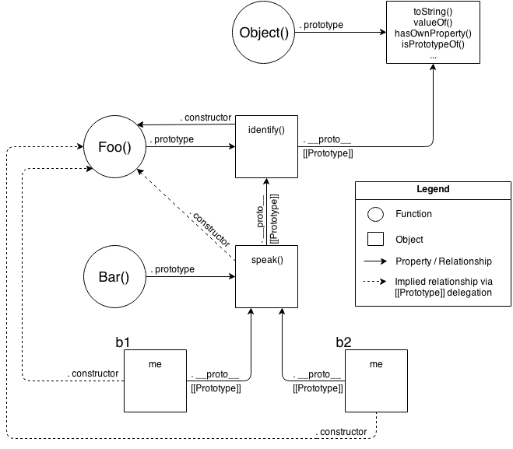
Prototypes
Prototypal Inheritance
Mental model
of standard
prototypal
inheritance
Notes:
Proto3

Slide 15
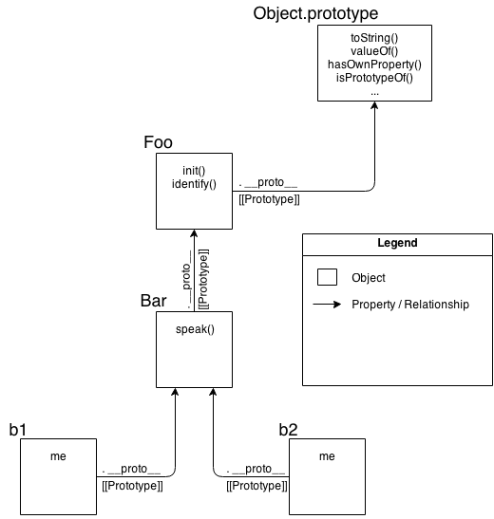
OLOO Delegation
Mental model for OLOO style delegation
”Objects Linked to Other Objects”

Slide 16
Language Quirks
- Or common misunderstandings
Hoisting of functions and vars
Coercion
Truthy and falsy values
== vs ===
this

Slide 17
Hoisting
Compiler processes variable and function declarations first
Function declarations are hoisted – function expressions are not
Notes:
Show hoisting1, hoisting2
Then bullet,
Then hoisting 1a, 2a
The 3a – Note typeError, not referenceError
Function declarations are hoisted, but function expressions are not!

Slide 18
Coercion
Values can be implicitly or explicitly coerced to other types
== vs ===

Slide 19
Falsy values
All of JavaScript's values can be divided into two categories:
Values that will become false if coerced to boolean
Everything else (which will obviously become true)
Falsy values:
undefined
null
false
0, and NaN
“”

Slide 20
this
function f(val) {
this.value = val; // What is this?
}
Notes:
Well it depends on the call site:
Is the function called with new (new binding)? If so, this is the newly constructed object.
var bar = new foo()
Is the function called with call or apply (explicit binding), even hidden inside a bind hard binding? If so, this is the explicitly specified object.
var bar = foo.call( obj2 )
Is the function called with a context (implicit binding), otherwise known as an owning or containing object? If so,this is that context object.
var bar = obj1.foo()
Otherwise, default the this (default binding). If in strict mode, pick undefined, otherwise pick the globalobject.
var bar = foo()

Slide 21
Exercises
http://www.codewars.com/kata/basic-training-add-item-to-an-array
http://www.codewars.com/kata/even-or-odd
http://www.codewars.com/kata/are-you-playing-banjo
http://www.codewars.com/kata/a-function-within-a-function
http://www.codewars.com/kata/even-or-odd
http://www.codewars.com/kata/max-headroom-and-javascript-style
http://www.codewars.com/kata/shifty-closures
http://www.codewars.com/kata/anonymous-returns
http://www.codewars.com/kata/uniquepush-no-dupes
http://jhusain.github.io/learnrx/

